Slide 1
CT5102: Programming for Data Analytics Lecture 10: Packages
Dr. Jim Duggan,
School of Engineering & Informatics
National University of Ireland Galway.
https://github.com/JimDuggan/CT5102

Slide 2
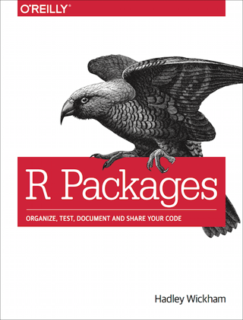
“Organise, test, document and share your code” (Wickham)
http://r-pkgs.had.co.nz/

Slide 3
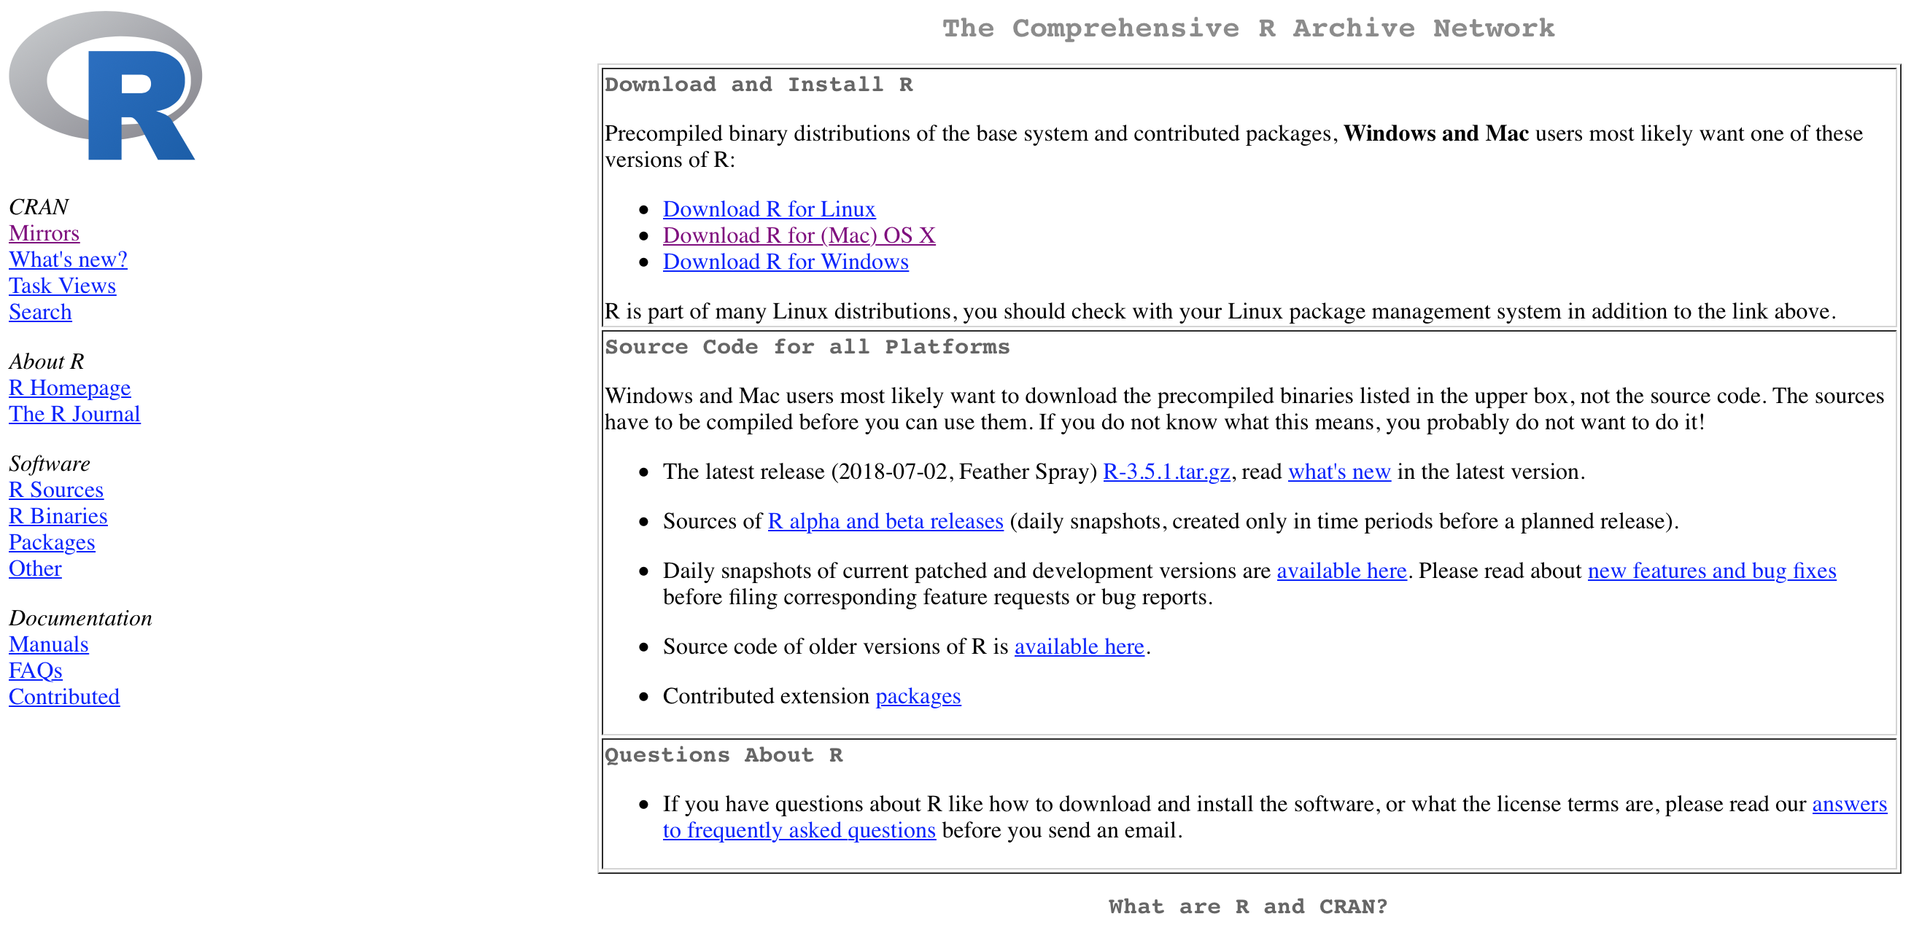
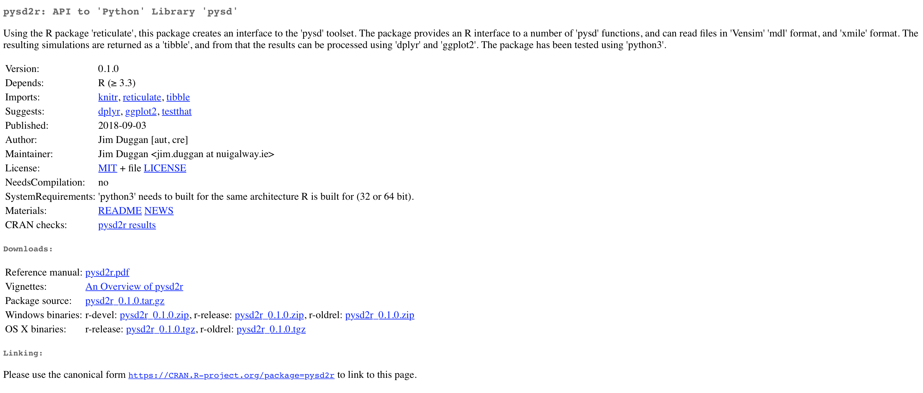
https://cran.r-project.org

Slide 4
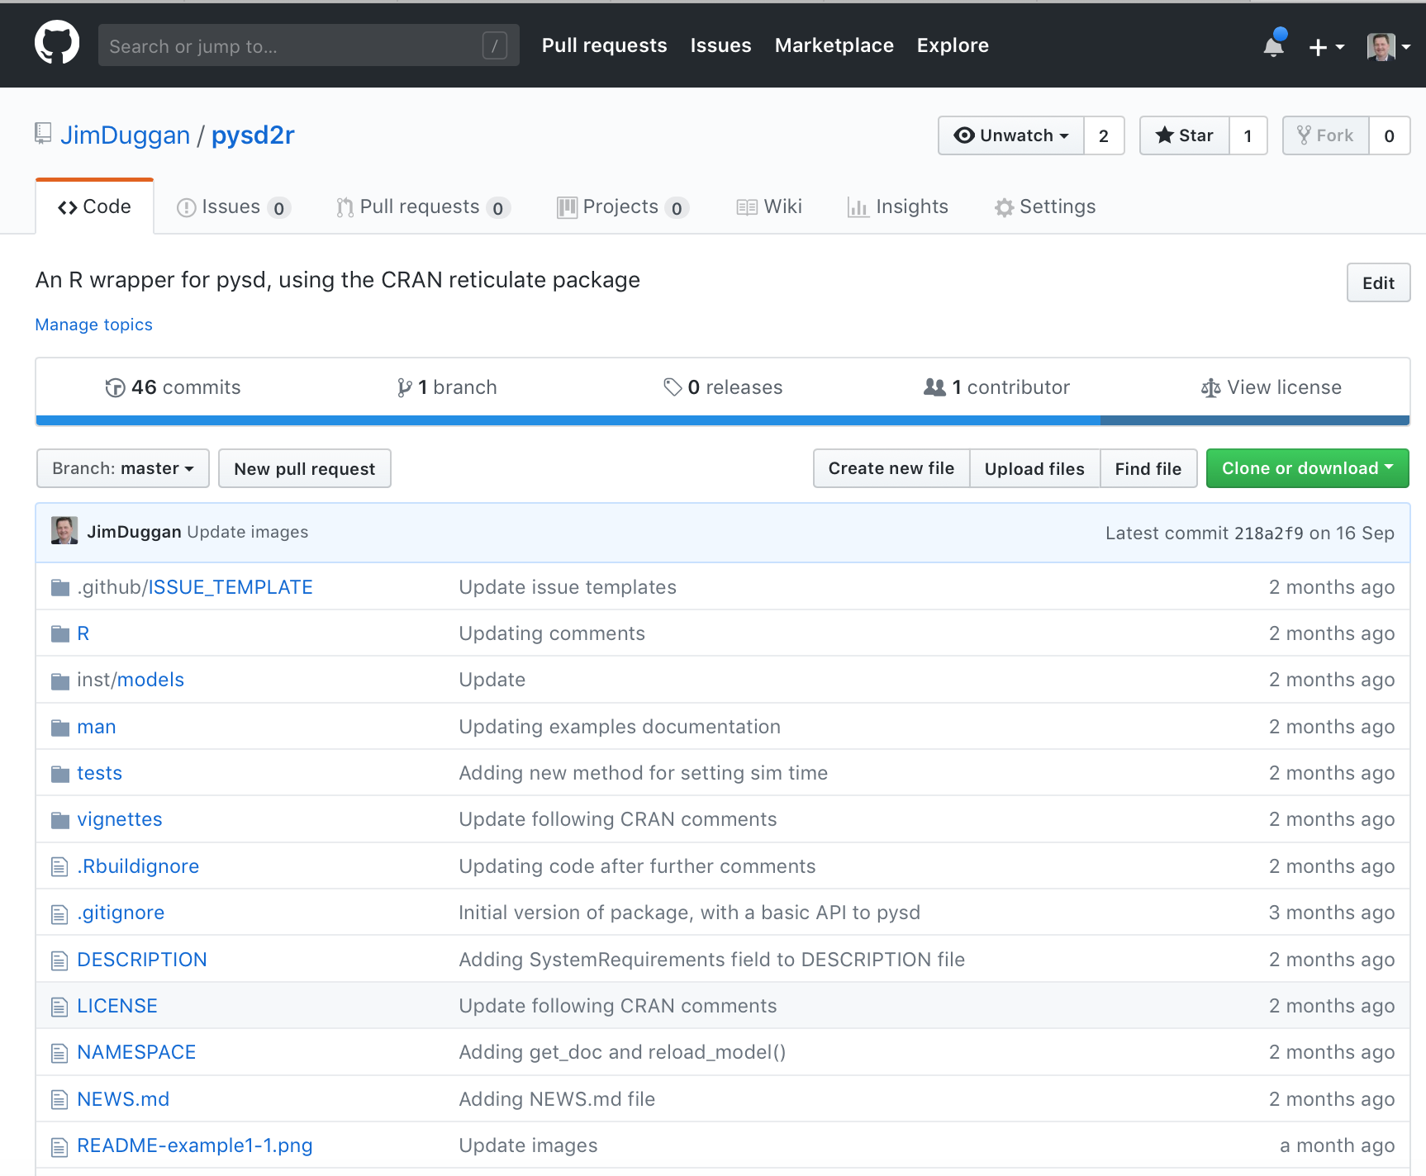
Packages also on github https://github.com/JimDuggan/pysd2r

Slide 5
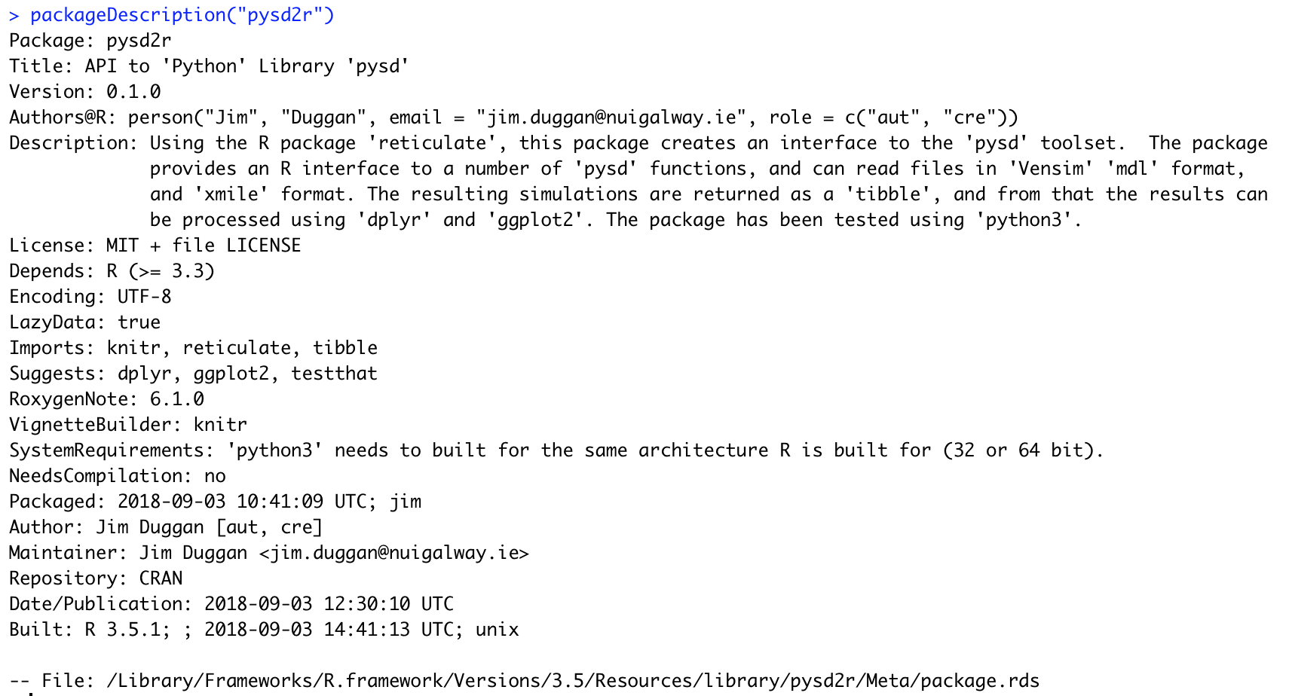
Accessing Package information…

Slide 6
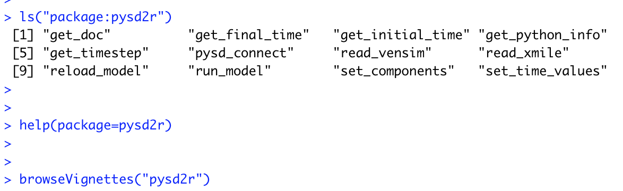
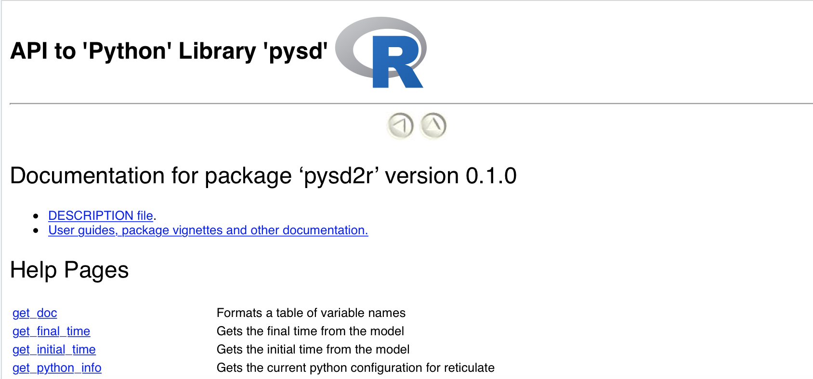
Other useful functions…

Slide 7
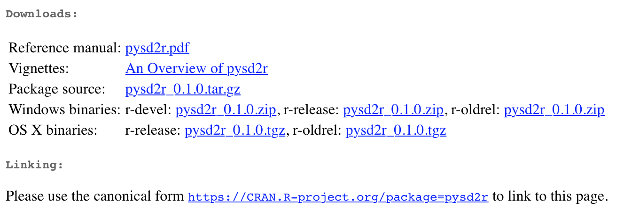
Types of package
Source
Files in a directory
Bundle
Files in a .tar.gz
Binary
R code cached
C code compiled
Installed
Directory in library
In memory
library()

Slide 8
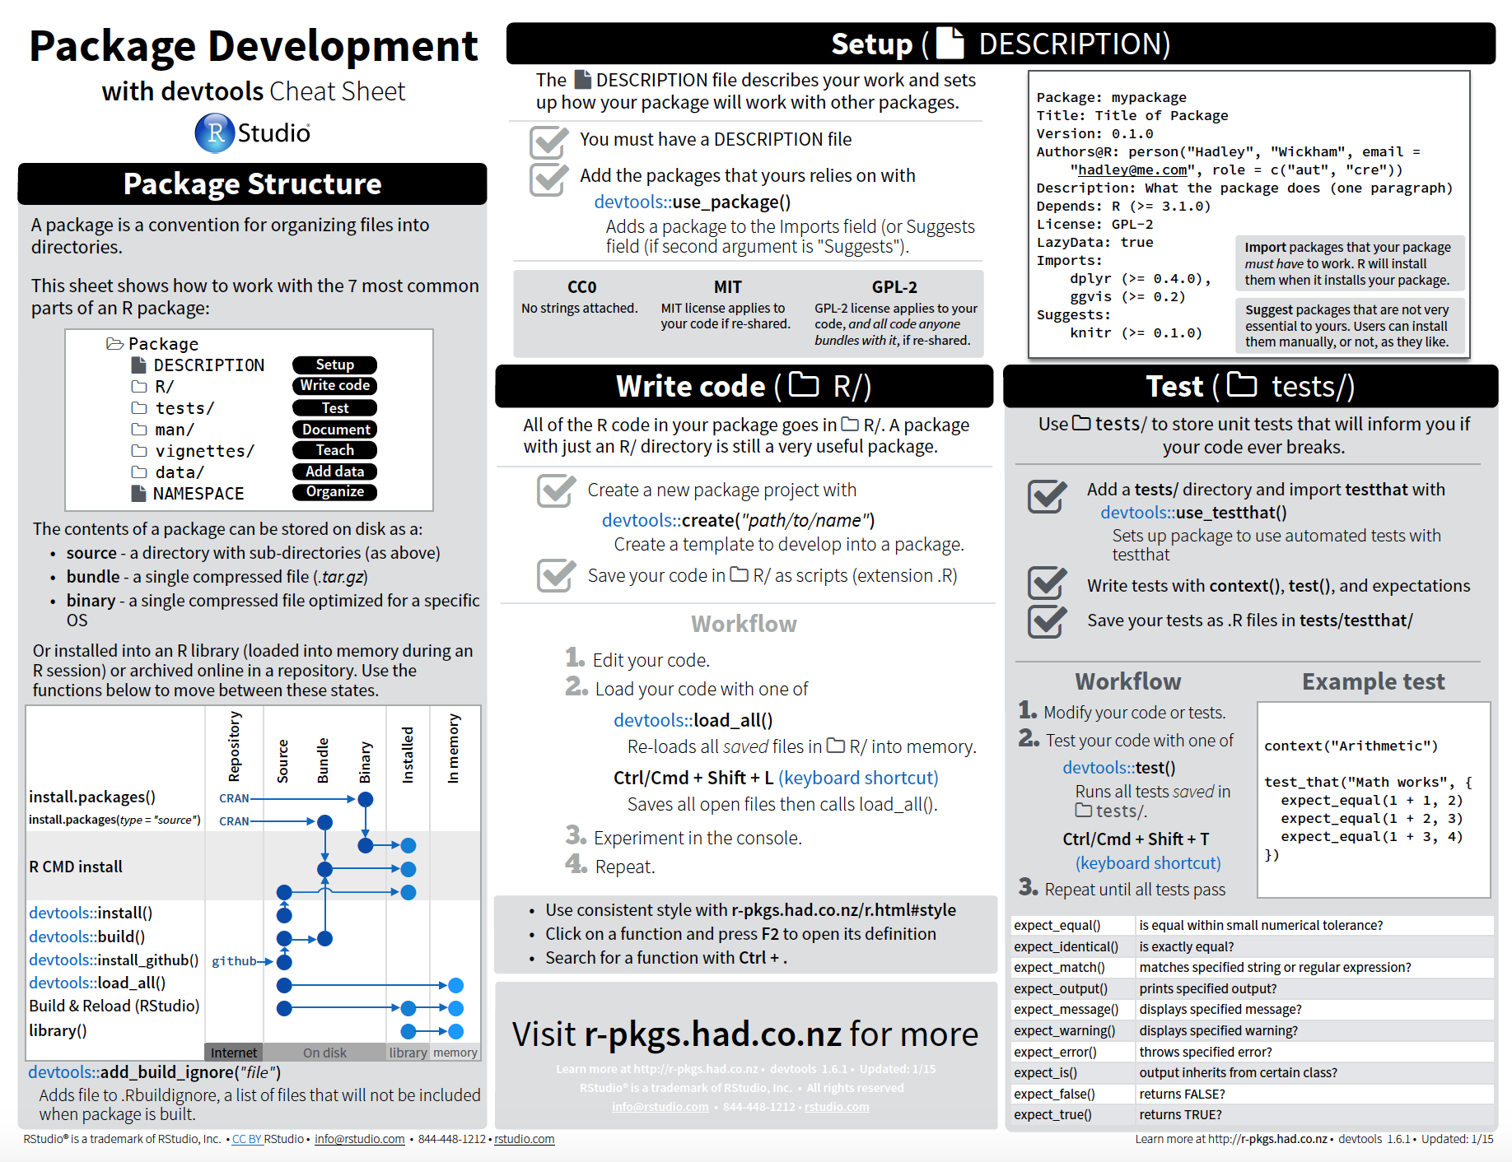
devtools - a key package

Slide 9
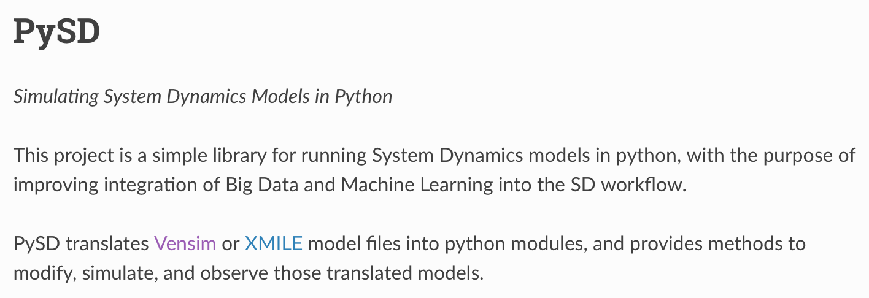
(1) Pick a name (Wickham)
Only lowercase letters and numbers
Add r (tidyr, stringr)
Be googleable!
Be memorable
Once you have a name, you can create a package

Slide 10
Our example: stackp
An S3 stack class as a demo
Create a tar.gz file, and also install from github
Can store a stack of any data type (list structure used)
Method | Description
stackp() | Constructor to create the stackp object
push(s,v) | Push the value v onto the stack s (generic)
peek(s) | Get the top value from the stack s (generic)
pop() | Remove the top value from the stack (generic)
summary() | Summarise the stack entries (generic)

Slide 11
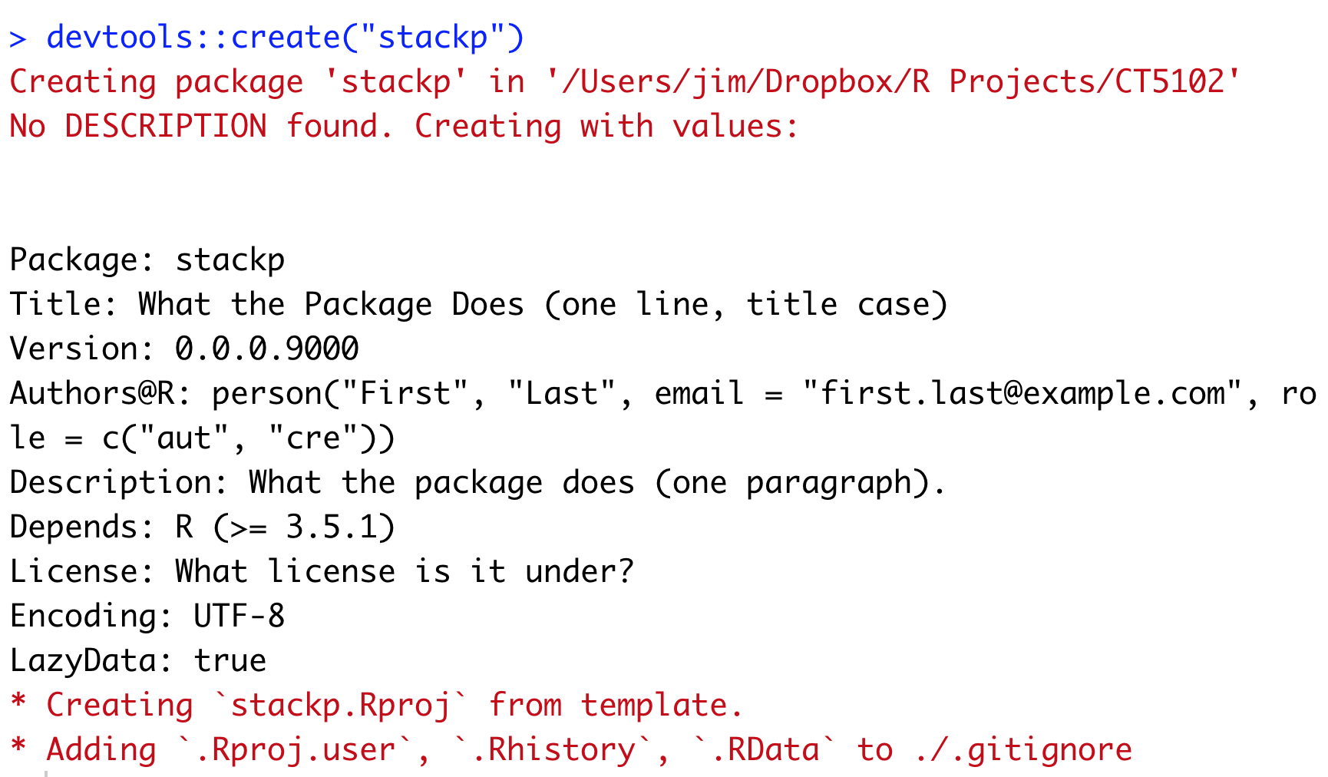
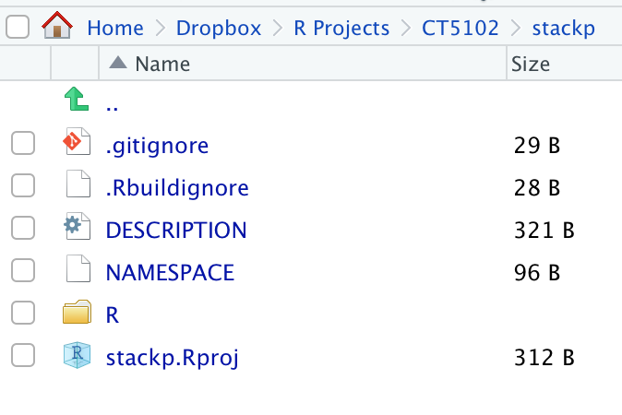
(2) Create the package devtools::create(“stackp”)
Open the new project stackp in RStudio

Slide 12
R/ is where your code lives load_all() allows you to test
Modify Code
load_all()
Cmd/Ctrl+Shift+L
Explore in Console

Slide 13
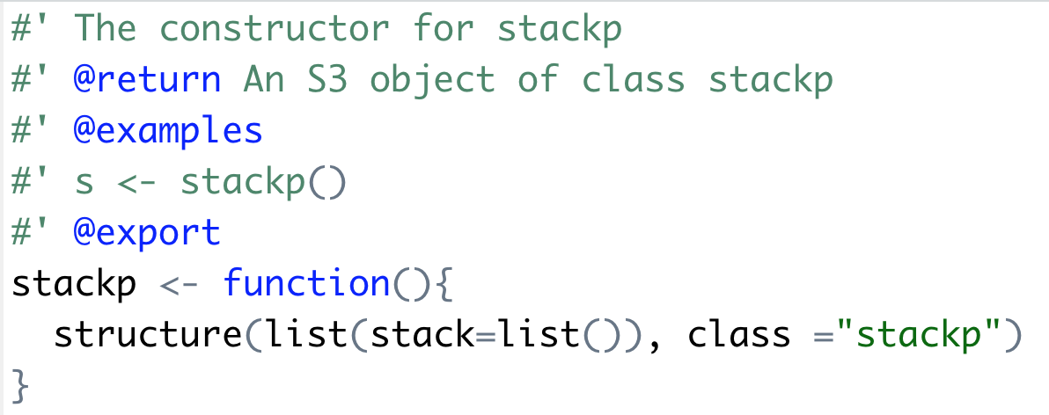
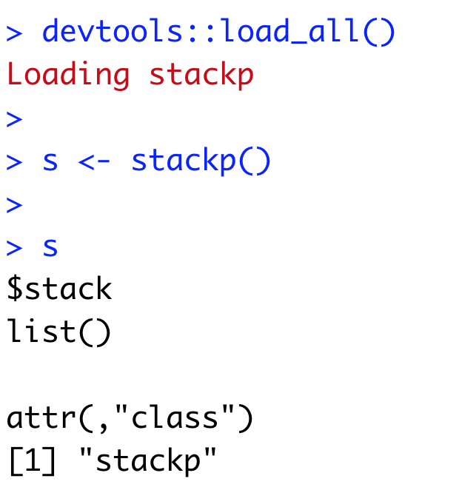
(3) Add code to R/

Slide 14
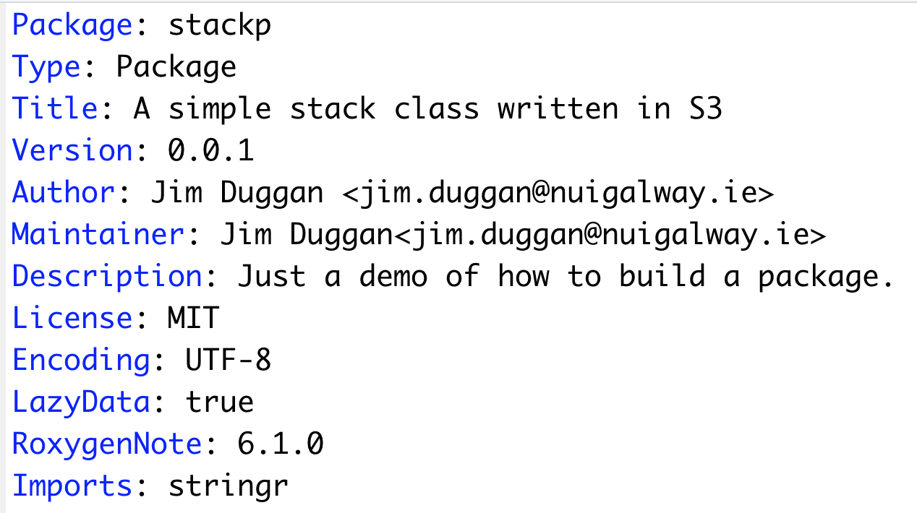
(4) Update default DESCRIPTION file

Slide 15
(5) Create help files http://r-pkgs.had.co.nz/man.html
Documentation is one of the most important aspects of a good package.
Without it, users won’t know how to use your package.
Documentation is also useful for future-use (so you remember what your functions were supposed to do), and for developers extending your package

Slide 16
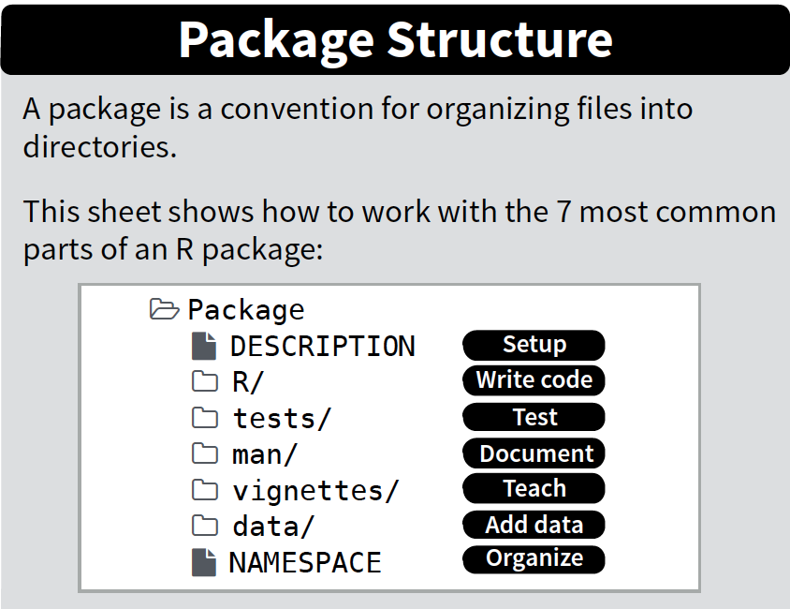
Create /man sub-directory
R Comments
roxygen2
Rd2roxygen
R
RD files
HTML

Slide 17
Roxygen
roxygen lets you write documentation inline in your .R files with a shorthand syntax.
Add roxygen documentation as comment lines that begin with #’.
Place comment lines directly above the code that defines the object documented.
Place a roxygen @ tag (right) after #’ to supply a specific section of documentation.
Untagged lines will be used to generate a title, description, and details section (in that order)

Slide 18
Workflow (Wickham)
NB You must have loaded the package with load_all() at least once
devtools::document()
Cmd/Ctrl+Shift+D
Modify R
Comment
Update RD files
Preview
HTML

Slide 19
Common Tags
Tag | Purpose
@param arg | Describe function inputs
@examples | Show how the function works
@seealso | Pointers to related functions
@return | Describe outputs (value)
@export | To be discussed

Slide 20
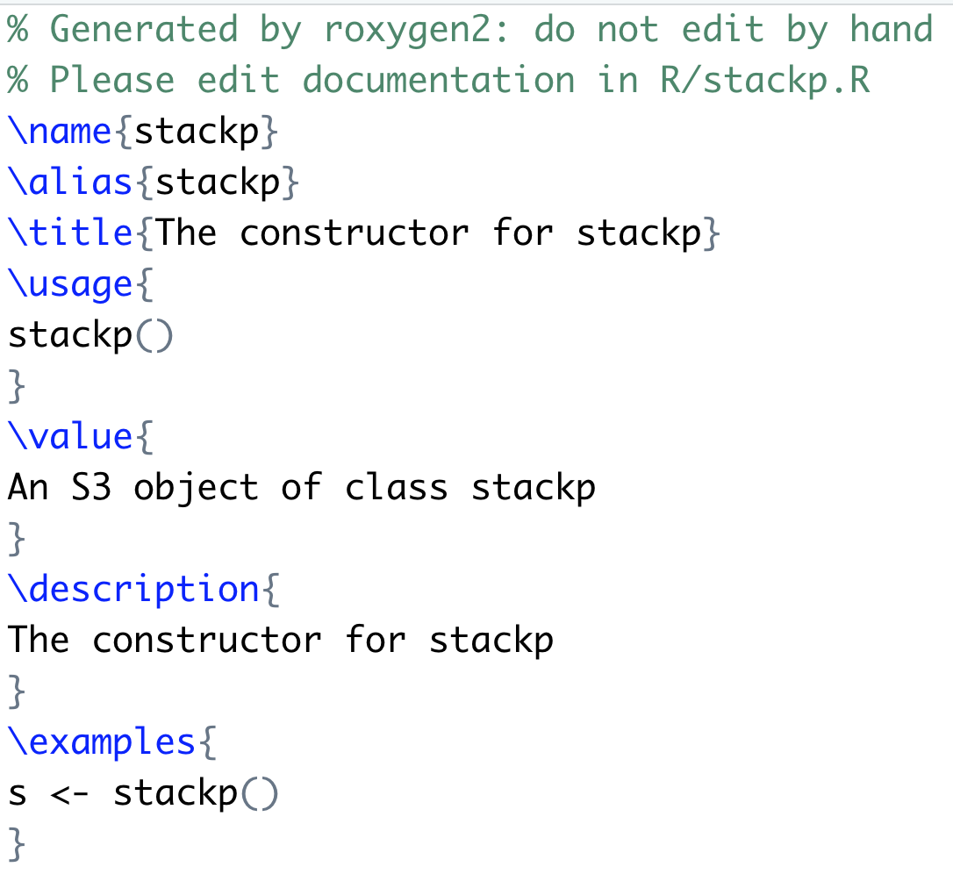
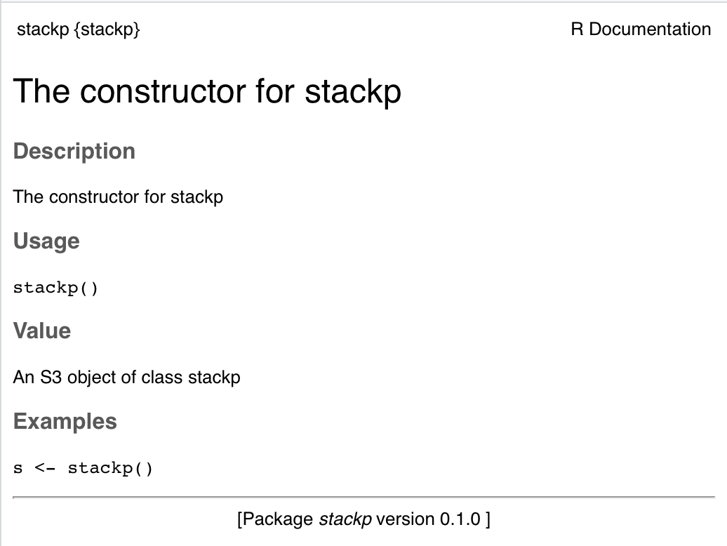
RD Files & Preview ?stackp will also work at the console

Slide 21
Text Formatting with Rd
Tag | Purpose
\code{} | Inline R Code
\eqn{} | Inline equation (latex)
\emph{} | Italic Text
\strong{} | Bold text
\link{foo} | Link to foo in the current package
\link[bar]{foo} | Link to foo in package bar
\url{http://rstudio.com} | Link to website
\email{j@mail.com} | Email address

Slide 22
Revised Workflow
devtools::document()
Cmd/Ctrl+Shift+D
Modify R
Comment
Update RD files
Check
Documentation
is OK
devtools::check_man()

Slide 23
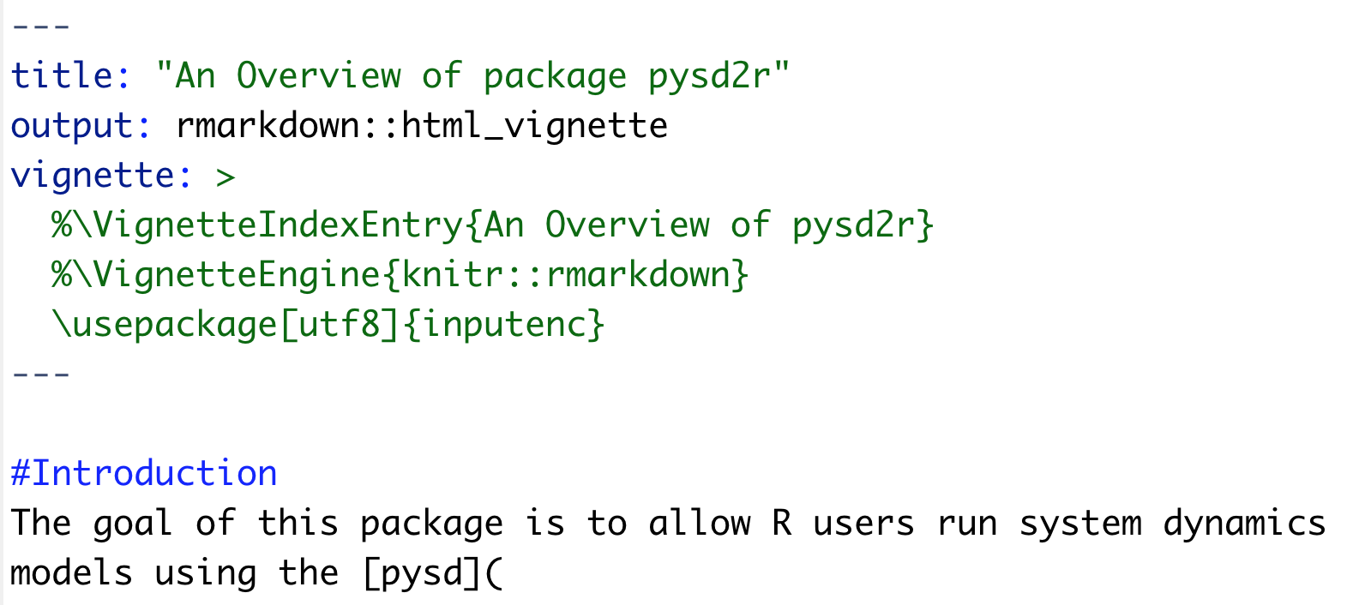
(6) Vignettes
Lets you combine code and prose to explain how your package works
devtools::use_vignette(“name”)
Adds to DESCRIPTION

Slide 24
(7) NAMESPACE
A NAMESPACE splits a function into two classes
Default NAMESPACE exports everything – better to export functions explicitly
Internal | External
Only for use within the package | For use by others
Documentation optional | Must be documented
Easily changed | Changing will break other people’s code

Slide 25
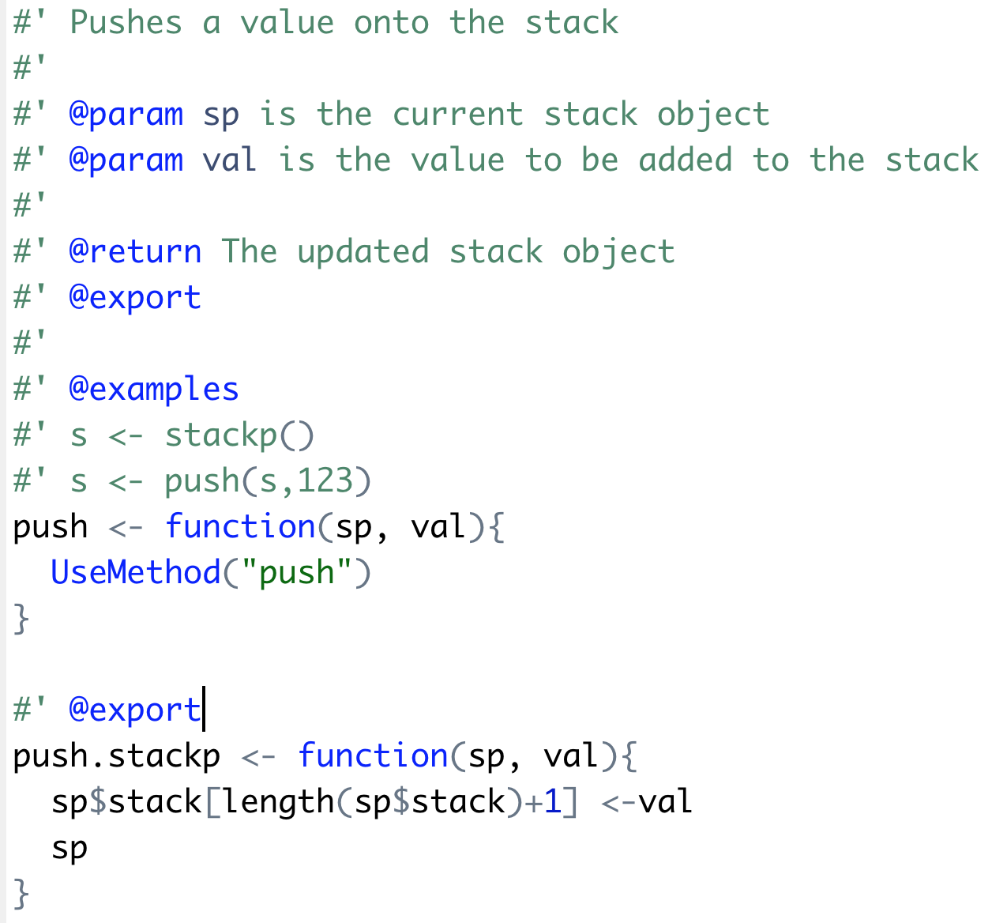
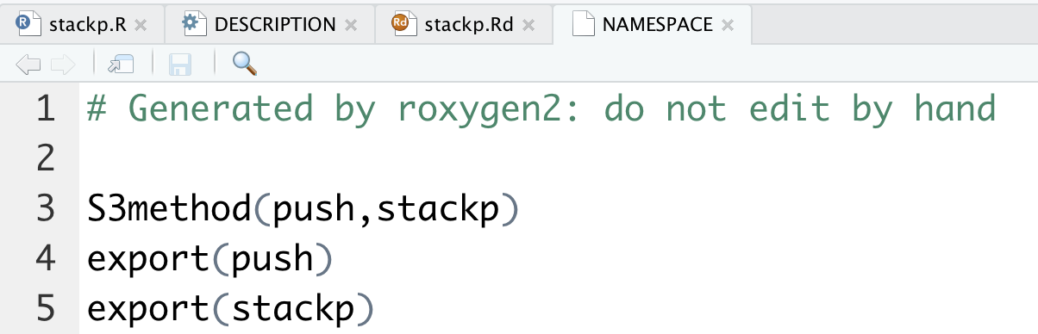
devtools::check()

Slide 26
@export generates the right NAMESPACE directive (Wickham)
Object type | Namespace Directive
Function | export()
S3 method | S3method()
S4 class | exportClass()
S4 method | exportMethods()

Slide 27
(7) Adding Tests – Why Test?
Correctness
Ensure current correctness
Interactive feedback
Reduce maintenance burden
Design
Think adversarially
Enable refactoring
Force good design
Working with others
Guard against future developers
Communicate with colleagues
Guard against complex interactions
Social pressure
Establish interfaces
http://matthewrocklin.com/blog/work/2016/02/08/tests

Slide 28
testthat package (Wickham)
Provides easy transition from informal to formal tests.
Can be used in wide variety of situations.
Wide range of expectations/assertions.
Fun output designed to keep you motivated.
Currently used by over 1100 packages.
Write R
Code
Run Automated
Tests
devtools::test()

Slide 29
How to create tests (Wickham)
Compare with known outputs.
Compare with results calculated another way.
Whenever you find a bug, first figure out the right answer and write a test.
Test areas that are likely to fail (i.e. complicated bits).
Focus on improving tests over time, not being perfect when you first start.

Slide 30
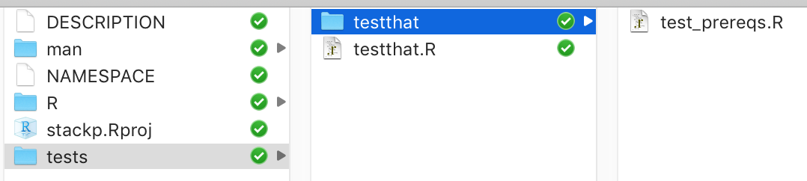
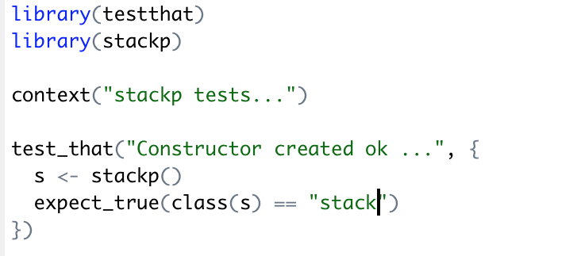
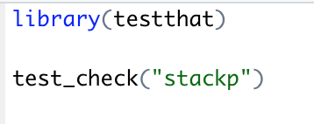
testthat.R & test_prereqs.R

Slide 31
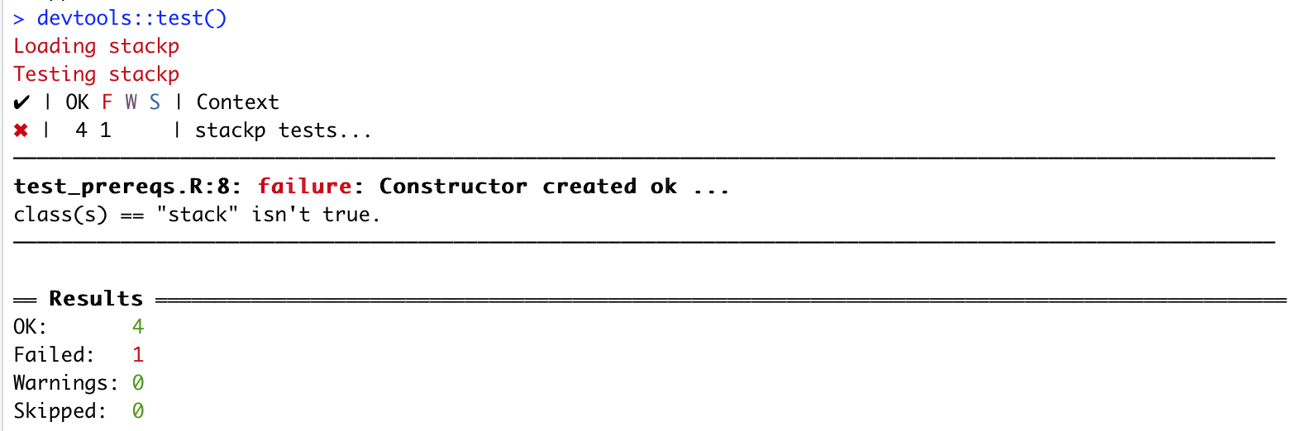
Running tests…

Slide 32
testthat functions
Abbreviation | Test
expect_equal() | Uses all.equal(), ignores floating point differences
expect_identical() | Uses identical() for stricter numerical testing.
expect_equivalent() | Like expect_equal(), but also ignores differences in attributes.
expect_is() | Check that inherits from a given class.
expect_true() / expect_false() | Catch all expectations for anything not otherwise covered

Slide 33
testthat functions
Abbreviation | Test
expect_matches() | Does any value match the supplied regular expression?
expect_output() | Does printed output match the supplied regular expression?
expect_message() | Does displayed messages match the supplied regular expression?
expect_warning() | Do any warnings match supplied regular expression?
expect_error() | Do any errors match supplied regular expression?

Slide 34
(8) Checking, Build and Install
devtools::check()
Runs automated checks for common problems in R packages
devtools::build()
Builds a tar.gz file for sharing
Install from github or a local file

Slide 35
Types of Problem
Error
Must fix!
Warning
Fix if submitting to CRAN
NOTE
Fix if submitting to CRAN
 | Local | CRAN
ERROR | Fix | Fix
WARNING |  | Fix
NOTE |  | Fix

Slide 36
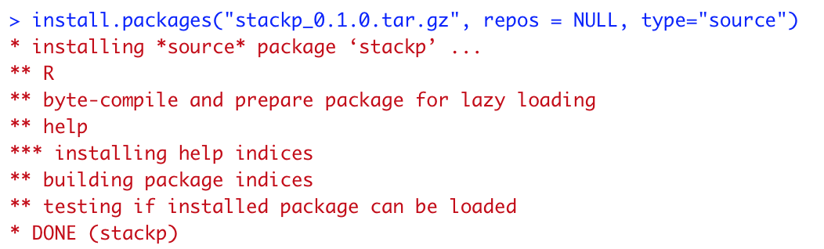
Install from local file

Slide 37
CRAN Process (Wickham)
Check
devtools::check()
Modify R
Code
Check with
R-devel
devtools::build_win()
Submit to
CRAN
Success!
devtools::release()

Slide 38
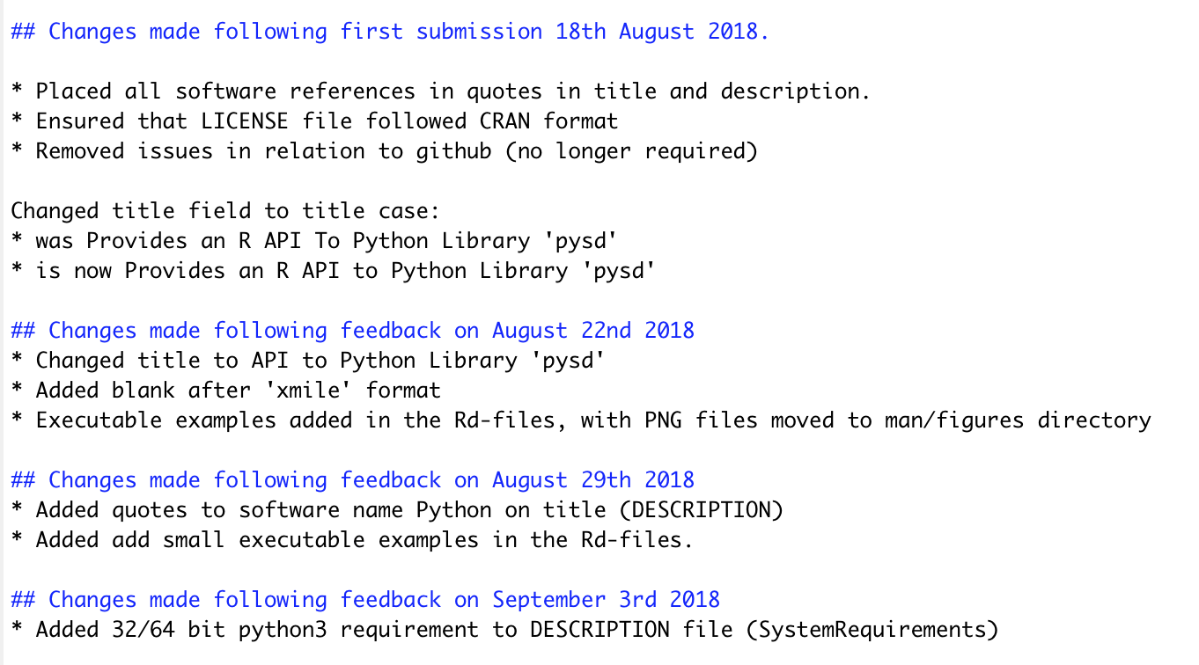
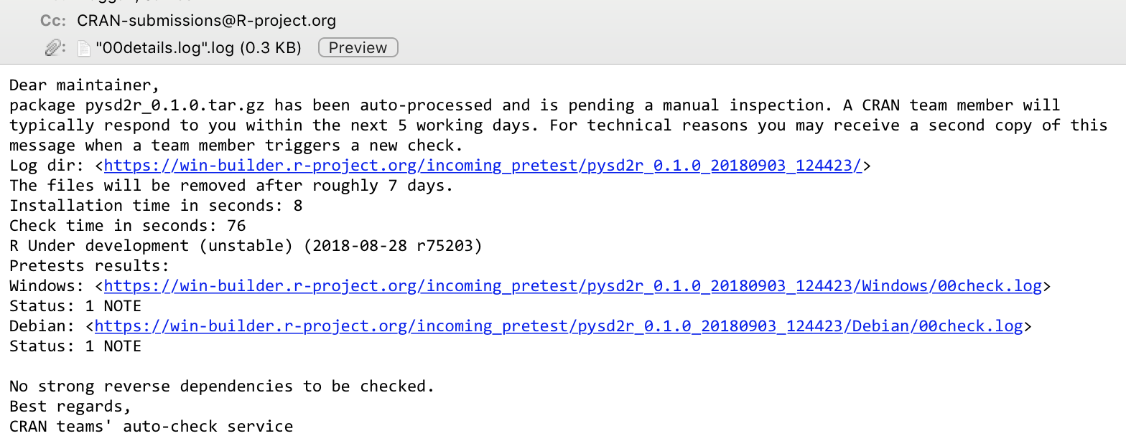
Final Stages of CRAN Process cran-comments.md

Slide 39
Summary
Package structure facilitates excellent software design
Sharing of code, design of useful modules
Can be used:
“in-house” – private
github (shared)
CRAN – widely available, and approved through a formal process

